Slide 1

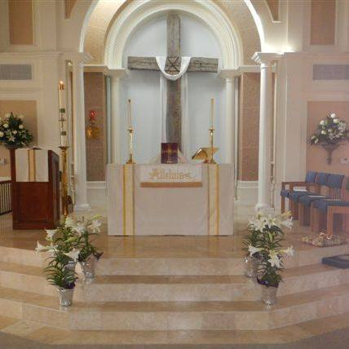

The Episcopal Church of the Redeemer, MO
September 25, 2023

Slide 2

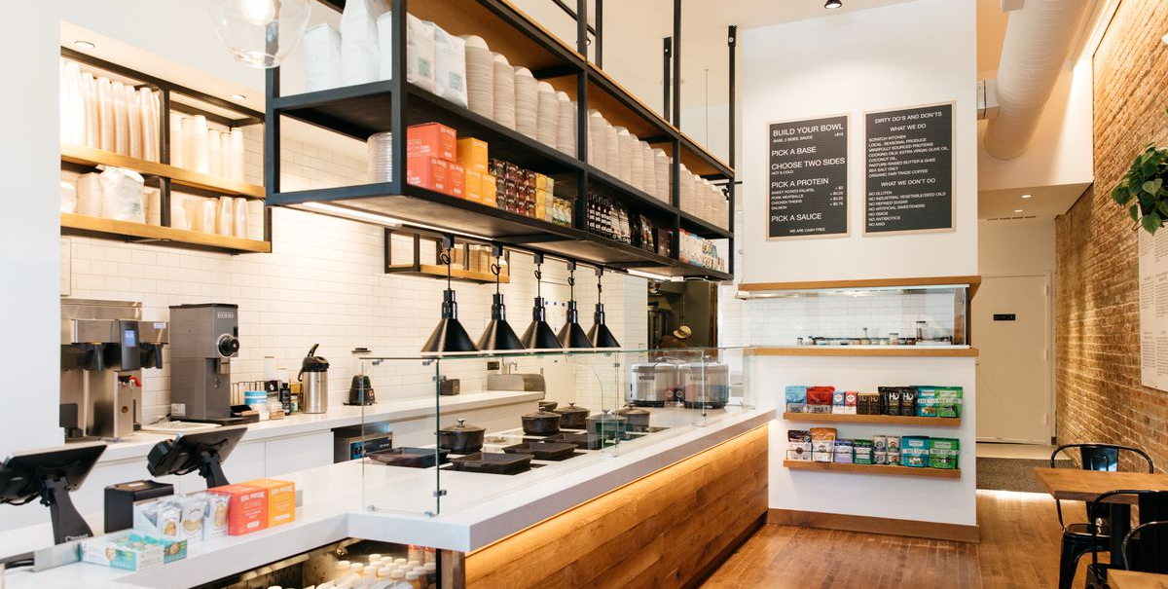

Why we do what we do the way we do it.
We all go through the report together at one time.
We benchmark.
We have to listen empathetically.
We know your data, but we don’t know your story.

Slide 3
Successful Transition
Transition Plan (Ready Church)
Search Plan (Right Clergy)
Start-Up Plan (Running Start)

Slide 5
Satisfaction
Peace
Fulfillment
Wholeness
Belonging
Meaningful relationships
Absence of discord
Energy
Compelling Sense of Purpose
Force of Engagement
Passion with Intention

Slide 7
Three priorities for your congregation
Growth: Comprehensive strategy to reach new people and incorporate them into the life of the church.
Growth: Make necessary changes to attract families with children and youth to our church.
Ministry (Internal/External): Develop ministries that work toward healing those broken by life circumstances.

Slide 9
High Energy
High Energy
Low Satisfaction
Chaos
Transformational
Low Satisfaction
High Satisfaction
Low Energy
Low Satisfaction
Low Energy
High Satisfaction
Low Energy

Slide 11



Priorities – Where do We Want to Go?

Slide 13
2%
41%
57%

Slide 14
21%

Slide 15
15%
22%

Slide 16

Who are We?
Descriptive Indices

Slide 19
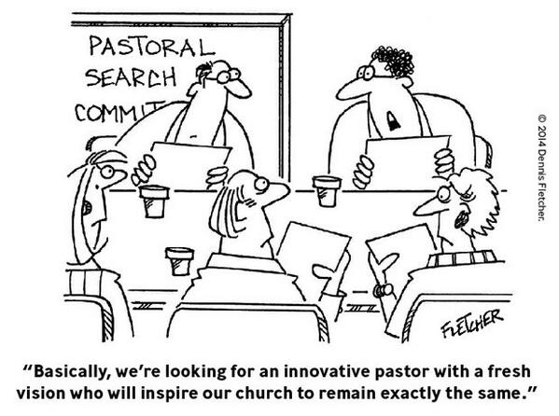

Slide 20
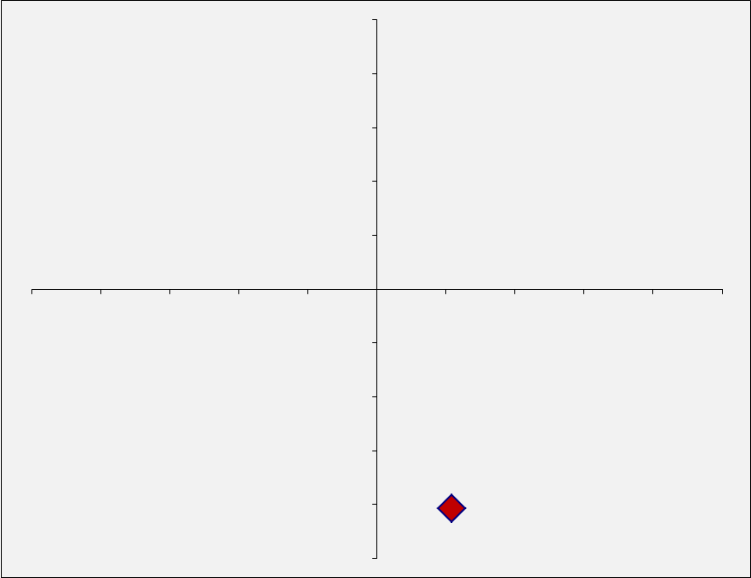

Descriptive Map
Adaptable
MAGI
PERFORMANCE
MAGI
PERFORMANCE
Progressive
Conservative
PARACLETE
HEARTH
AND HOME
HEARTH & HOME
PARACLETE
Settled
113

Slide 21
Paraclete
Develop communities that are intellectually open and reflective but that pays attention to structure and ritual.
Common to hear conversation about hospitality, inclusiveness, and spiritual practice.
Comfortable with the unique spiritual path each individual must follow but believe that there are important patterns to spiritual practice.
Uniquely equipped to focus on ministries of healing-often engaged in front line work-when the community is warm and hospitable, it can be a haven for those in need of healing or recovery.
Prepares members to deal with the harshness of cultural and political realities in ministry.

Slide 22
Paraclete Shadow Side
If missional focus is lost may find themselves going through the motions of set routines, rather than finding the deeper meaning.
Watch the temptation to overcommit to meeting the needs of others to the extent that there is burnout.
May get trapped in the acceptance of where people are without adequate levels of accountability that can help make people whole.
The power of the gospel to transform must remain a focus, not just its power to comfort.

Slide 23

How are We Doing?
Performance Indices

Slide 24
Sample Benchmarking

Slide 40

Summary

Slide 41
Transition work
How do we think about how our worship can adapt for those we want to reach?
Review ministry opportunities and gift discernment
What are members wanting in the programming that will be fulfilling

Slide 42



Anxiety around change is best handled by:
Helping people feel invested
Communication and transparency
Celebrating accomplishments
Sharing the good work of the congregation
Remember how change has happened and how we have navigated it.

Slide 43

Who is your next good fit:
Someone who can speak and teach on both sides theologically and can foster healthy conversation in differences.
Someone who can help create healthy balance between internal focus and external focus
Someone who can partner well with the music and help discern how to grow that part of worship
Someone who is strategic in their leadership and able to help leadership leverage skills and gifts within that strategic plan.
Someone who can deepen your spiritual practice in meaningful ways

Slide 44
